Slide 1
A Young Male With Idiopathic Hepatic Encephalopathy And A Necrotic Lower Extremity
Evan D. Schmitz, M.D.
Pulmonary & Critical Care Fellow
Carl T. Hayden Phoenix VA/Good Samaritan Hospital
Notes:
1

Slide 2
History of Present Illness
A 32 yo male presented to an outside hospital with dyspnea and altered mental status and was emergently intubated
He was diagnosed with liver failure and a lower extremity soft tissue infection
He subsequently developed E. coli bacteremia,septic shock, ARDS and was transferred.

Slide 3
History of Present Illness
His family said that over the last two months he was complaining of increasing swelling in his legs as well as diarrhea.
His family said that his co-workers had noticed odd behavior recently.
They also noticed that he started to look pale and then his eyes and skin turned yellow.

Slide 4
Past Medical History
No history of trauma
No past medical history
No family history of liver or lung disease
No family history of diabetes

Slide 5
Social History
No history of illicit drugs or tobacco
No history of anabolic steroid use
He drank about 3 beers a day
He used the supplements phosphocreatine, rip fuel and energy drinks for over a year.

Slide 6
Physical Exam
Vitals: BP 88/30 HR 103 RR 35
Gen - Obtunded
HEENT - Scleral icterus
Cardiac - Tachycardic, no m/r/g
Lungs - Tachypneic, diminished breath sounds BL
Abd - Distended abdomen with fluid shift
Ext - 4+ pitting edema and necrotic lesion on left leg

Slide 7
Labs
ABG 7.05/37/260
WBC 6.9 Platelets 289,000
Hgb 6.5
Na+ 123 Lactic acid 9.2 BC grew E. Coli
K+ 4.2 Ammonia 58 INR 2.1
CL 93 Bilirubin 2.2 PTT 44.9
HCO3 9 AST 82 UA 1.020, + bili
BUN 33 ALT 77
Cr 2.5 Albumin 1.4
Gluc 51

Slide 8
Imaging
Notes:
8

Slide 10
Which diagnostic test should be ordered?
Liver biopsy
Lung biopsy
Soft tissue biopsy
Bronchoscopy
V/Q scan

Slide 11
What is the diagnosis?
Dietary supplement-associated liver, skin and lung injury
Sepsis with shock liver and ARDS
Hantavirus
Alpha-1 antiprotease deficiency
Respiratory syncitial virus

Slide 12
Pathology
Notes:
12

Slide 13
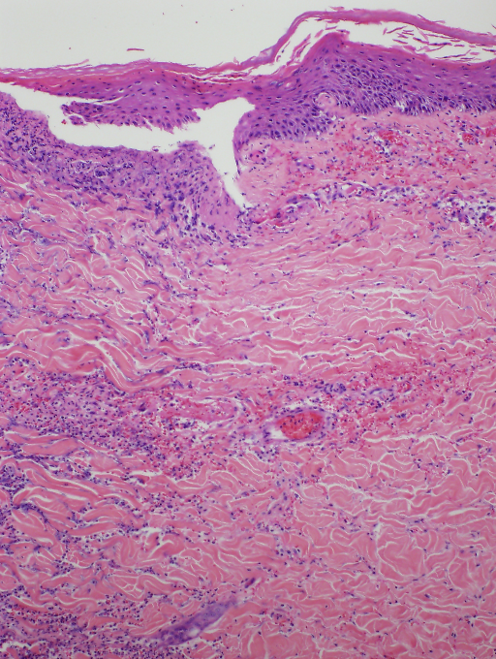
Notes:
13

Slide 14
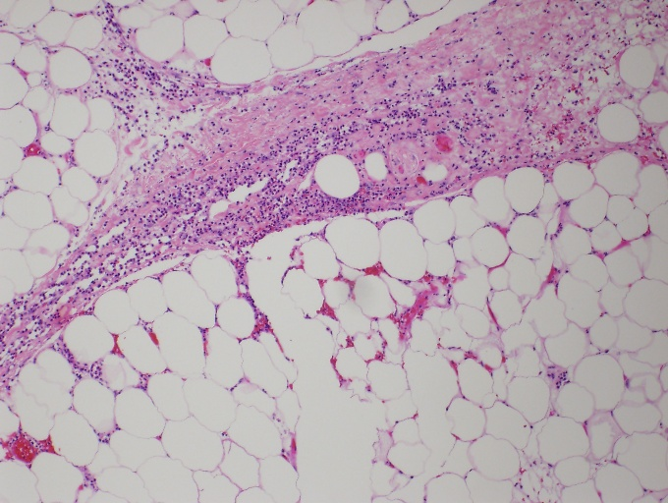
Notes:
14

Slide 15
Serum Testing
Serum alpha-1 antitrypsin level < 30 mg/dl
Repeat alpha-1 antitrypsin level < 30 mg/dl
Phenotype PIZZ

Slide 16
Manifestations of AAT Deficiency
Emphysema
Hepatic disease
Panniculitis
Vascular disease
Inflammatory bowel disease
Glomerulonephritis
ANCA-positive vasculitis

Slide 17
Phenotype

Slide 18
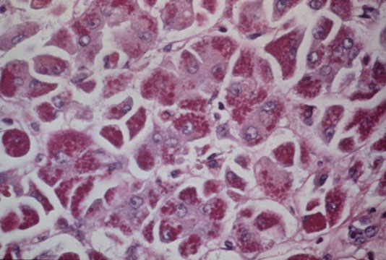
Hepatic Disease
Liver disease is caused by polymerization of the variant AAT protein which results in intrahepatocyte accumulation
PIZZ is the most common phenotype

Slide 19
Panniculitis
Necrotizing panniculitis is caused by unopposedproteolysis in the skin which leads to lobular fat necrosis of the lower reticular dermis
Patients develop a hot and painful red nodule or plaque that may progress to necrosis if left untreated

Slide 20
References
American Thoracic Society/European Respiratory Society Statement: Standards for the Diagnosis and Management of
Individuals with Alpha-1 Antitrypsin Deficiency. Am J Respir Crit Care Med 2003
American Thoracic Society/European Respiratory Society Standards document for the diagnosis and managament of
individuals with alpha-1 antitrypsin deficiency. Am J Respir Crit Care Med 2003; 168:818
Teckman et al. Molecular pathogensis of liver disease in alpha-1 antitrypsin deficiency. Hepatology 1996; 24:1504
Perlmutter et al. Molecular pathogenesis of alpha-1 antitrypsin deficiency associated liver disease: a meeting review.
Hepatology 2007; 45:1313
Stoller et al. Panniculitis in alpha-1 antitrypsin deficiency. Clin Pulm Med 2008; 15:113
Tobin et al. Alpha-1 antitrypsin deficiency: The clinical and physiological features of pulmonary emphysema in subjects
homozygous for PI-type Z: A survey by the British Thoracic Association. Br J Dis Chest 1983; 77:14

